Slide 1










TEAM INTRODUCTION
.
.
.
.
.
.
.
.
.
.
.
.
.
.
.
.
.
.
.
.
Tolulope Arayinbo
PRESIDENT
Olasunbo Banjoko
SQL DEVELOPER
Michael Sholeye
SQL DEVELOPER
Olajumoke Owuye
DATA ANALYST
Adedoyin Damilare
DATA ANALYST
Babatunde Adeyale
CO-ORDINATOR
Taiwo Ogundipe
DATA ANALYST
Olayinka Obasemo
SQL DEVELOPER
Salam Odulawa
SQL DEVELOPER
Onyedikachukwu Duru
DATA ANALYST

Slide 2
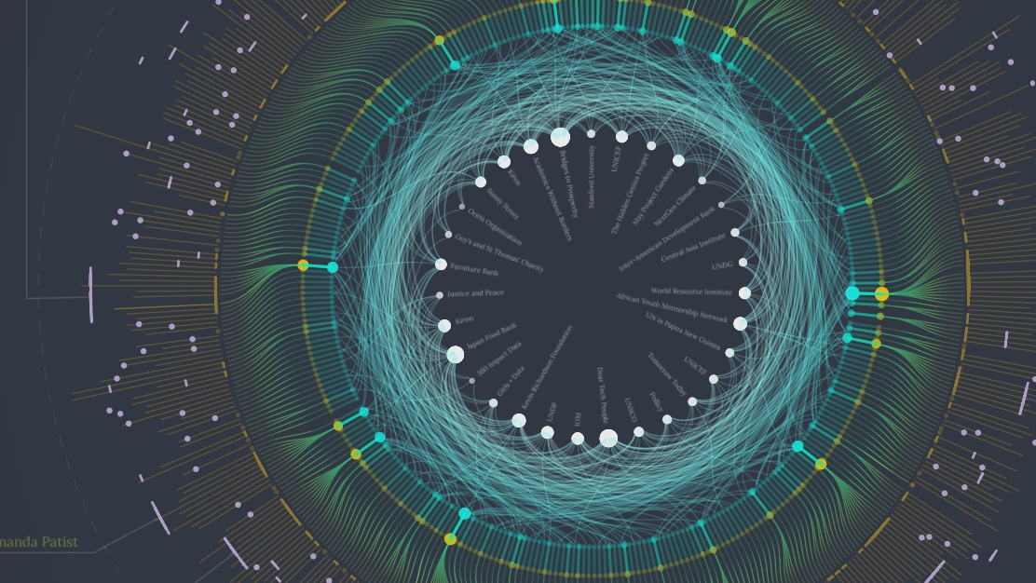

SCENARIO
We are a data analyst at SkyBarrel Solutions. SkyBarrel recently got a contract in Florida and we have been staffed to work on the 12 months contract as the Data Analyst at the bank. Due to our immense SQL experience, we have been tasked with generating several reports for the bank executive leadership. These reports are meant to provide a number of insights to the Leadership on Borrower/Loan Analytics and Reporting.

Slide 3
FUNCTIONS USED FOR THIS PROJECT
CONCAT
CONCAT_WS
FORMAT
RIGHT
STUFF
C0
AVG
COUNT
FLOOR
MAX
SUM
MIN
DATEDIFF
GETDATE

Slide 4
SQL JOIN
LEFT JOIN
RIGHT JOIN
Table1
Borrower
Table2
LoanSetup
Table 2
LoanSetup
Table 1
Information
Borrower
INNER JOIN
Information
Table1
Borrower
H.
Table 2
LoanSetup
Information

Slide 5


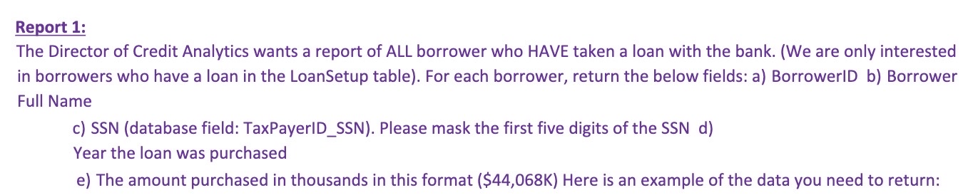
BUSINESS REQUIREMENTS

Slide 6
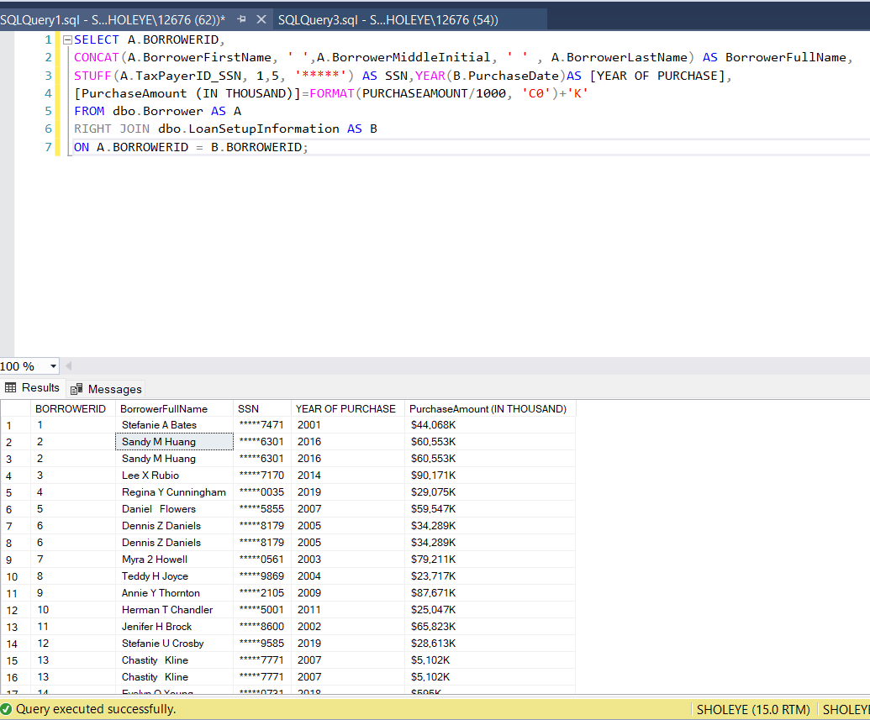
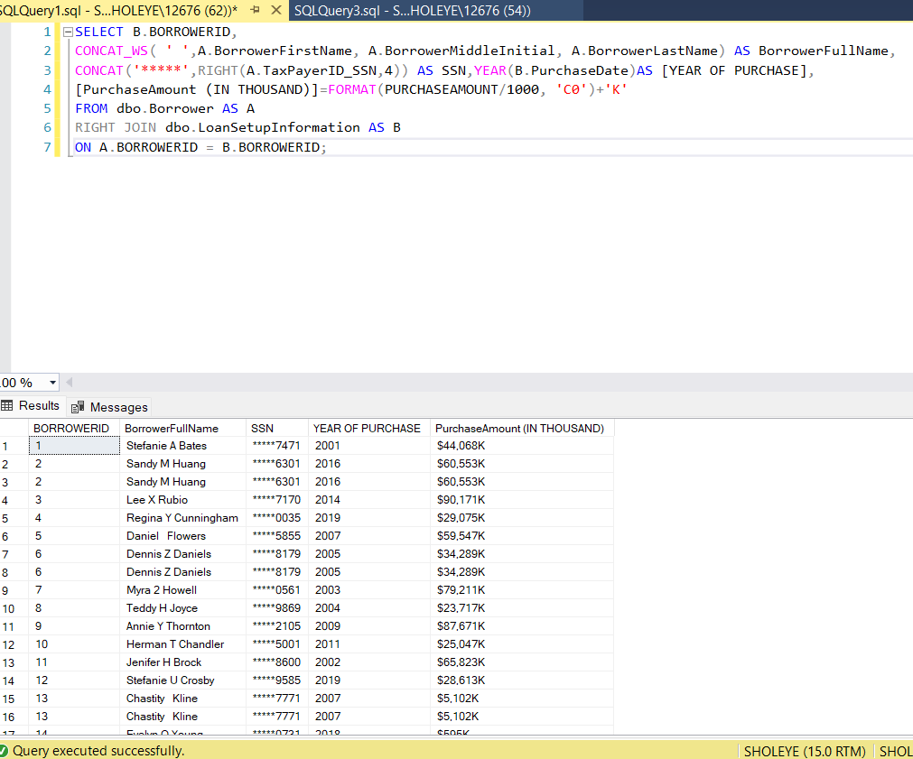
DIFFERENT WAYS TO WRITE THE CODE
1A
1A

Slide 7
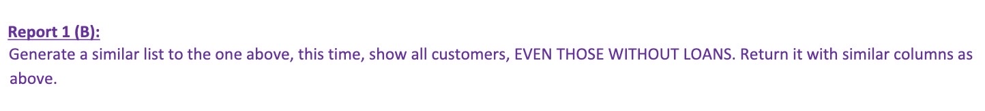

Slide 8
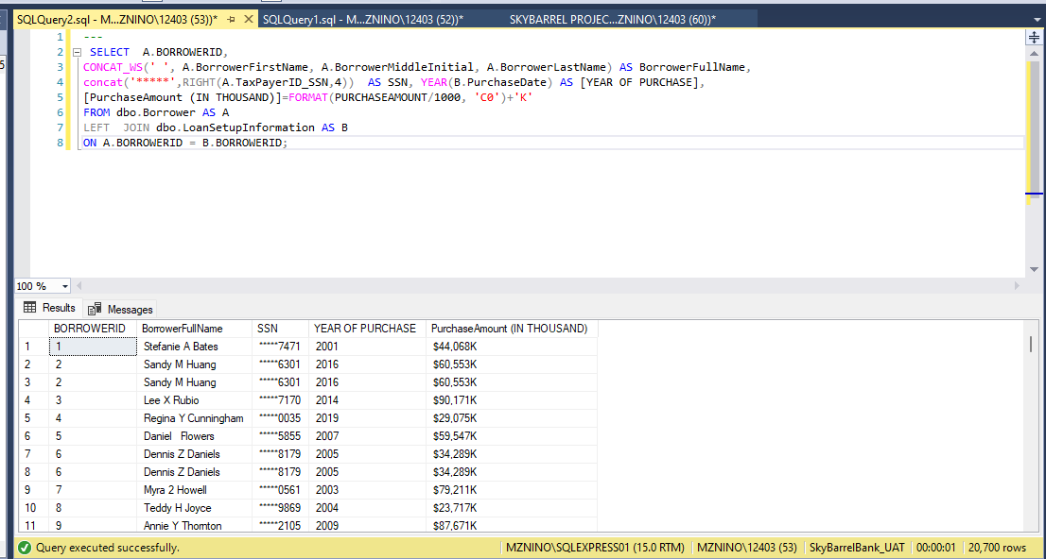
1B

Slide 9
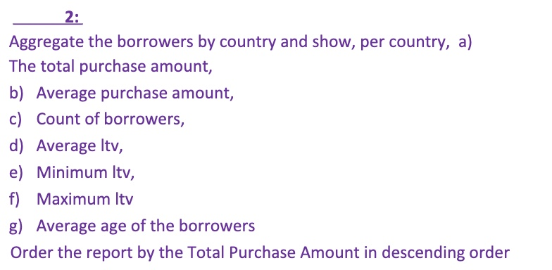

Slide 10
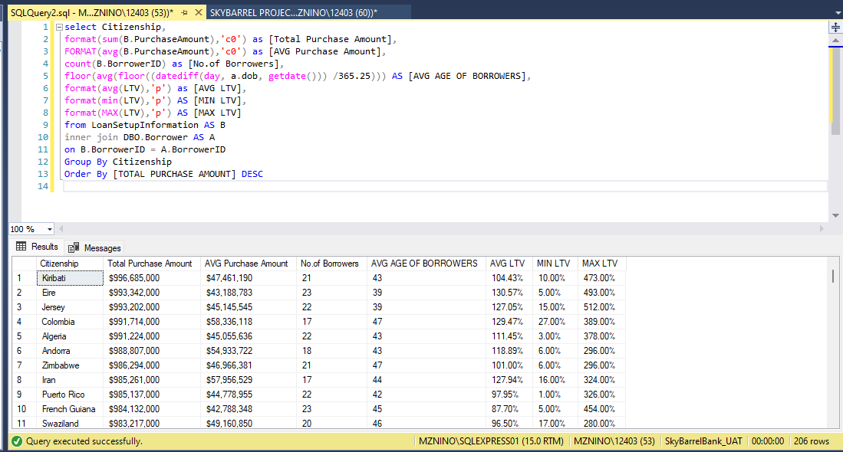
2A

Slide 11
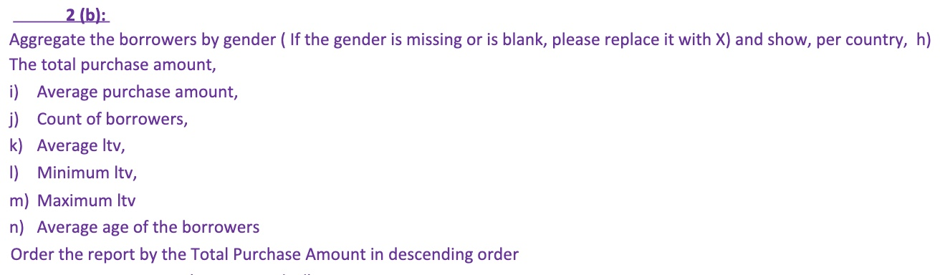

Slide 12
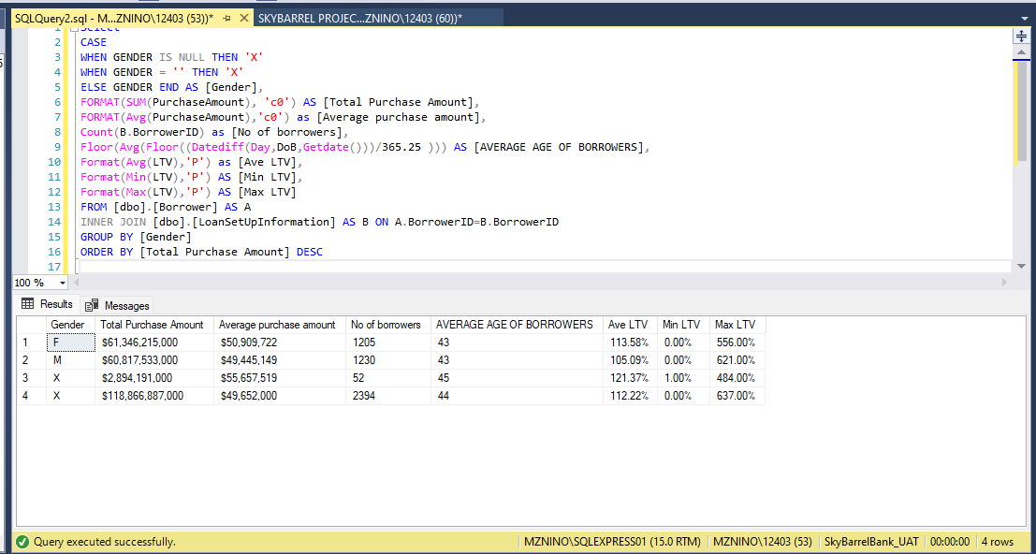
2B

Slide 13
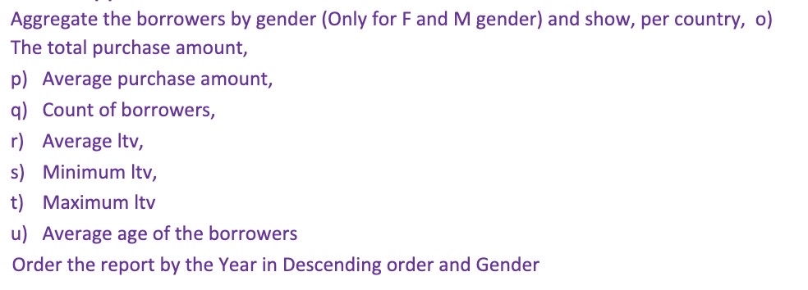
2C

Slide 14
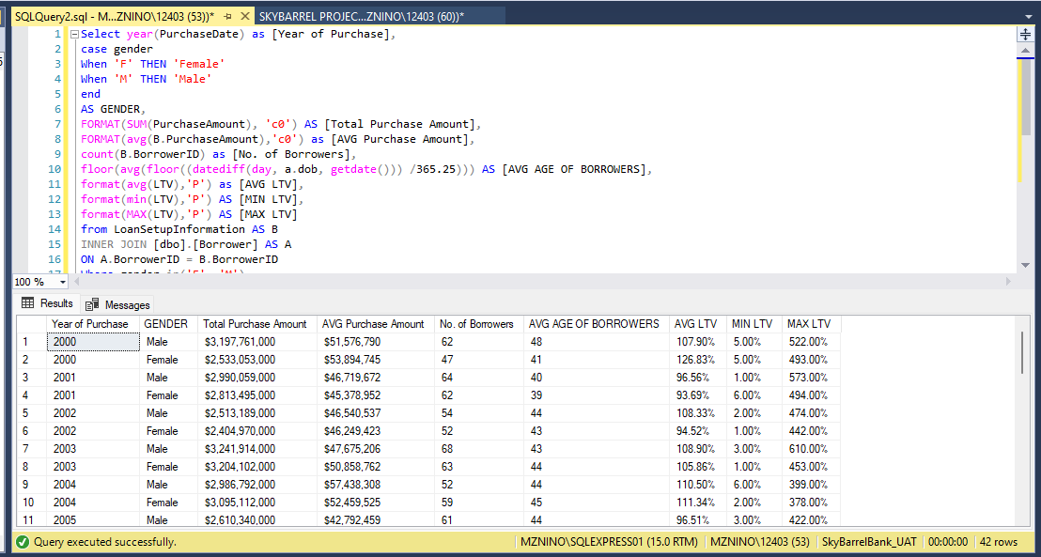
2C

Slide 15
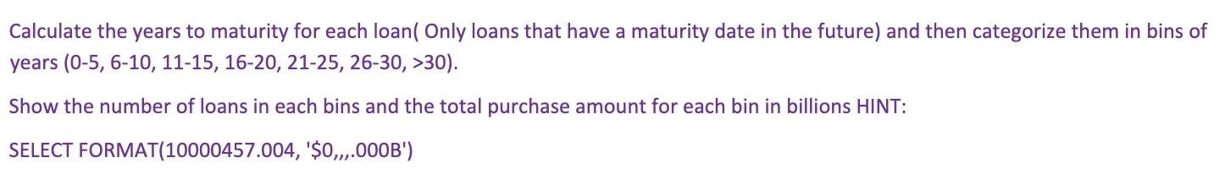
3

Slide 16
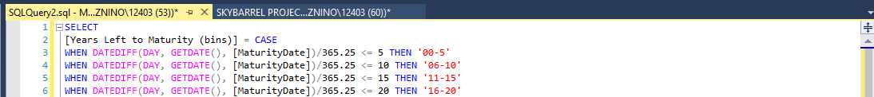
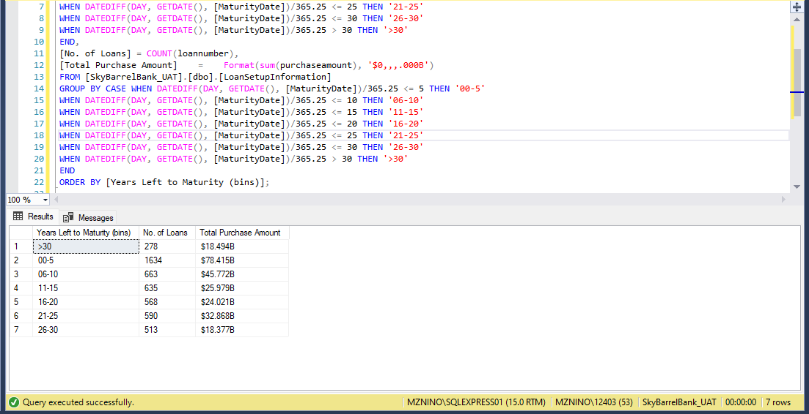
3

Slide 17
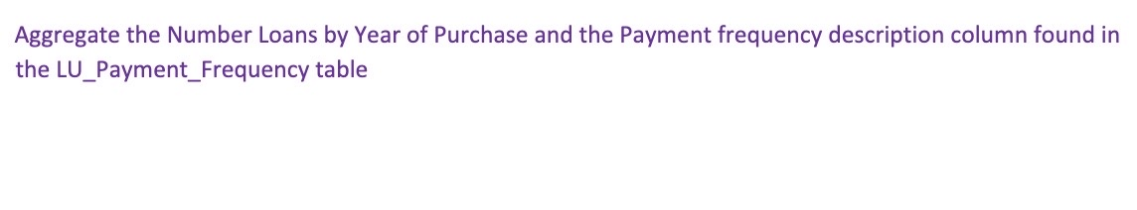
4

Slide 18
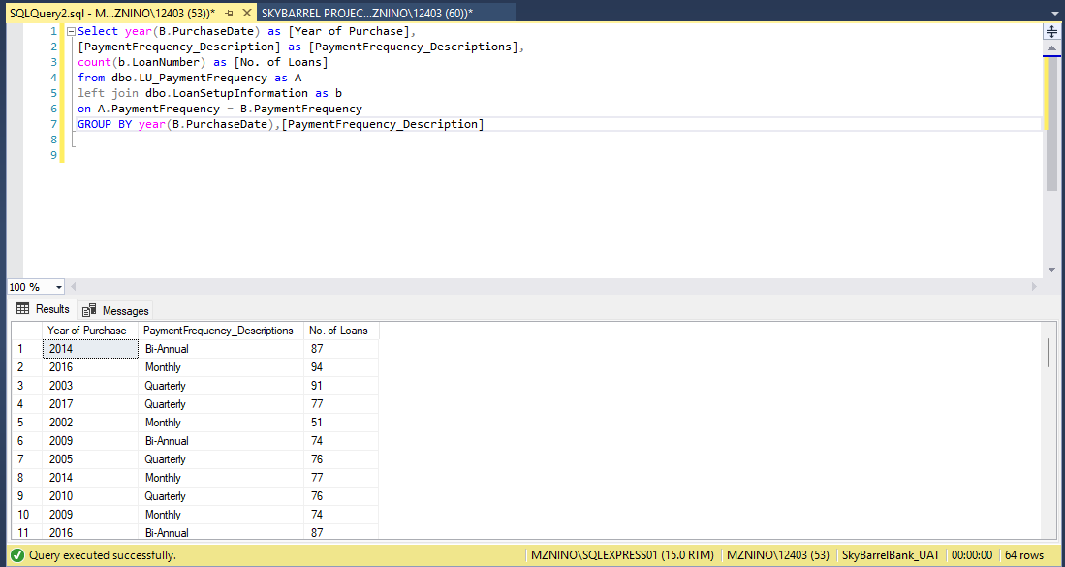
4

Slide 19

QUESTION

